Slide 1




Visualizing changes over time using dynamic hierarchies: TreeVersity2 and the StemView
John Alexis Guerra Gómez, Michael L. Pack, Catherine Plaisant and Ben Shneiderman

Slide 2
Product
Apples
Oranges
Milk
Bread
Butter
Orange Juice
Soda
So you are collecting some data

Slide 3
Product | Category | Refrigerate? | Boxed | QTY | Price
Apples
Oranges
Milk
Bread
Butter
Orange Juice
Soda
and it has many attributes

Slide 4
Product | Category | Refrigerate? | Boxed | QTY | Price
Apples |  |  |  | 230 | $1.5
Oranges |  |  |  | 210 | $5
Milk |  |  |  | 93 | $2
Bread |  |  |  | 105 | $3
Butter |  |  |  | 10 | $10
Orange Juice |  |  |  | 143 | $4
Soda |  |  |  | 150 | $7
some numerical

Slide 5
Product | Category | Refrigerate? | Boxed | QTY | Price
Apples | Fruit | No | No | 230 | $1.5
Oranges | Fruit | No | No | 210 | $5
Milk | Liquids | Yes | Yes | 93 | $2
Bread | Staple | No | No | 105 | $3
Butter | Staple | Yes | Yes | 10 | $10
Orange Juice | Liquids | Yes | Yes | 143 | $4
Soda | Liquids | Yes | Yes | 150 | $7
some categorical

Slide 6
Product | Category | Refrigerate? | Boxed | QTY | Price
Apples | Fruit | No | No | 230 | $1.5
Oranges | Fruit | No | No | 210 | $5
Milk | Liquids | Yes | Yes | 93 | $2
Bread | Staple | No | No | 105 | $3
Butter | Staple | Yes | Yes | 10 | $10
Orange Juice | Liquids | Yes | Yes | 143 | $4
Cheese | Liquids | Yes | Yes | 150 | $7
And it changes over time…

Slide 7
Product | Category | Refrigerate? | Boxed | QTY | Price
Apples | Fruit | No | No | 230 | $1.5
Oranges | Fruit | No | No | 210 | $5
Milk | Liquids | Yes | Yes | 93 | $2
Bread | Staple | No | No | 105 | $3
Butter | Staple | Yes | Yes | 10 | $10
Orange Juice | Liquids | Yes | Yes | 143 | $4
Cheese | Liquids | Yes | Yes | 150 | $7
Product | Category | Refrigerate? | Boxed | QTY | Price
Apples | Fruit | No | No | 245 | $2
Oranges | Fruit | No | No | 201 | $4
Milk | Liquids | Yes | Yes | 94 | $2
Bread | Staple | No | No | 102 | $3.5
Butter | Staple | Yes | Yes | 15 | $11
Orange Juice | Liquids | Yes | Yes | 170 | $4
Cheese | Liquids | Yes | Yes | 120 | $5
And it changes over time…

Slide 8
Product | Category | Refrigerate? | Boxed | QTY | Price
Apples | Fruit | No | No | 230 | $1.5
Oranges | Fruit | No | No | 210 | $5
Milk | Liquids | Yes | Yes | 93 | $2
Bread | Staple | No | No | 105 | $3
Butter | Staple | Yes | Yes | 10 | $10
Orange Juice | Liquids | Yes | Yes | 143 | $4
Cheese | Liquids | Yes | Yes | 150 | $7
Product | Category | Refrigerate? | Boxed | QTY | Price
Apples | Fruit | No | No | 245 | $2
Oranges | Fruit | No | No | 201 | $4
Milk | Liquids | Yes | Yes | 94 | $2
Bread | Staple | No | No | 102 | $3.5
Butter | Staple | Yes | Yes | 15 | $11
Orange Juice | Liquids | Yes | Yes | 170 | $4
Cheese | Liquids | Yes | Yes | 120 | $5
Product | Category | Refrigerate? | Boxed | QTY | Price
Apples | Fruit | No | No | 230 | $3
Oranges | Fruit | No | No | 220 | $4
Milk | Liquids | Yes | Yes | 110 | $4
Bread | Staple | No | No | 92 | $2
Butter | Staple | Yes | Yes | 10 | $8
Orange Juice | Liquids | Yes | Yes | 160 | $3
Cheese | Liquids | Yes | Yes | 150 | $7
And it changes over time…

Slide 9
Product | Category | Refrigerate? | Boxed | QTY | Price
Apples | Fruit | No | No | 230 | $1.5
Oranges | Fruit | No | No | 210 | $5
Milk | Liquids | Yes | Yes | 93 | $2
Bread | Staple | No | No | 105 | $3
Butter | Staple | Yes | Yes | 10 | $10
Orange Juice | Liquids | Yes | Yes | 143 | $4
Cheese | Liquids | Yes | Yes | 150 | $7
Product | Category | Refrigerate? | Boxed | QTY | Price
Apples | Fruit | No | No | 245 | $2
Oranges | Fruit | No | No | 201 | $4
Milk | Liquids | Yes | Yes | 94 | $2
Bread | Staple | No | No | 102 | $3.5
Butter | Staple | Yes | Yes | 15 | $11
Orange Juice | Liquids | Yes | Yes | 170 | $4
Cheese | Liquids | Yes | Yes | 120 | $5
Product | Category | Refrigerate? | Boxed | QTY | Price
Apples | Fruit | No | No | 230 | $3
Oranges | Fruit | No | No | 220 | $4
Milk | Liquids | Yes | Yes | 110 | $4
Bread | Staple | No | No | 92 | $2
Butter | Staple | Yes | Yes | 10 | $8
Orange Juice | Liquids | Yes | Yes | 160 | $3
Cheese | Liquids | Yes | Yes | 150 | $7
Product | Category | Refrigerate? | Boxed | QTY | Price
Apples | Fruit | No | No | 220 | $2
Oranges | Fruit | No | No | 110 | $3
Milk | Liquids | Yes | Yes | 95 | $1
Bread | Staple | No | No | 73 | $2
Cherries | Fruit | No | Yes | 22 | $7.1
Orange Juice | Liquids | Yes | Yes | 100 | $4
Soda | Liquids | Yes | Yes | 190 | $7
And it changes over time…

Slide 10
Product | Category | Refrigerate? | Boxed | QTY | Price
Apples | Fruit | No | No | 230 | $1.5
Oranges | Fruit | No | No | 210 | $5
Milk | Liquids | Yes | Yes | 93 | $2
Bread | Staple | No | No | 105 | $3
Butter | Staple | Yes | Yes | 10 | $10
Orange Juice | Liquids | Yes | Yes | 143 | $4
Cheese | Liquids | Yes | Yes | 150 | $7
Product | Category | Refrigerate? | Boxed | QTY | Price
Apples | Fruit | No | No | 245 | $2
Oranges | Fruit | No | No | 201 | $4
Milk | Liquids | Yes | Yes | 94 | $2
Bread | Staple | No | No | 102 | $3.5
Butter | Staple | Yes | Yes | 15 | $11
Orange Juice | Liquids | Yes | Yes | 170 | $4
Cheese | Liquids | Yes | Yes | 120 | $5
Product | Category | Refrigerate? | Boxed | QTY | Price
Apples | Fruit | No | No | 230 | $3
Oranges | Fruit | No | No | 220 | $4
Milk | Liquids | Yes | Yes | 110 | $4
Bread | Staple | No | No | 92 | $2
Butter | Staple | Yes | Yes | 10 | $8
Orange Juice | Liquids | Yes | Yes | 160 | $3
Cheese | Liquids | Yes | Yes | 150 | $7
Product | Category | Refrigerate? | Boxed | QTY | Price
Apples | Fruit | No | No | 220 | $2
Oranges | Fruit | No | No | 110 | $3
Milk | Liquids | Yes | Yes | 95 | $1
Bread | Staple | No | No | 73 | $2
Cherries | Fruit | No | Yes | 22 | $7.1
Orange Juice | Liquids | Yes | Yes | 100 | $4
Soda | Liquids | Yes | Yes | 190 | $7
?
What Changed?

Slide 11
Total
820

Slide 12
Total
820
Category?
Staple
83
Fruits
352
Liquids
385

Slide 13
Total
820
Category?
Staple
83
Fruits
352
Liquids
385
Boxed?
Yes
83
No
330
Yes
22
Yes
385

Slide 14
Total
820
Category?
Staple
83
Fruits
352
Liquids
385
Boxed?
Yes
83
No
330
Yes
22
Yes
385
Bread
73
Butter
10
Apples
220
Oranges
110
Cherries
22
Soda
190
Milk
95
Orange Juice
100

Slide 15
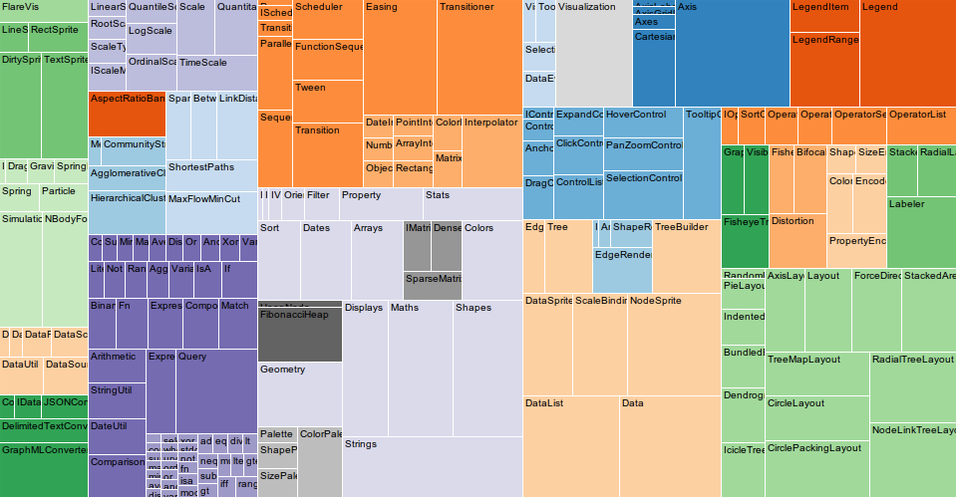
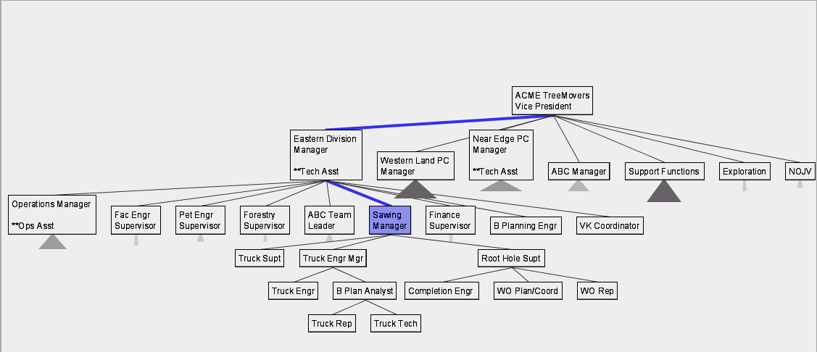
…and we are really good with them
TreeMaps [Johnson & Shneiderman 1991]
SpaceTree [Plaisant, Grosjean & Bederson 1998]
Visualizing
Navigating
Storing, Computing, etc…

Slide 16
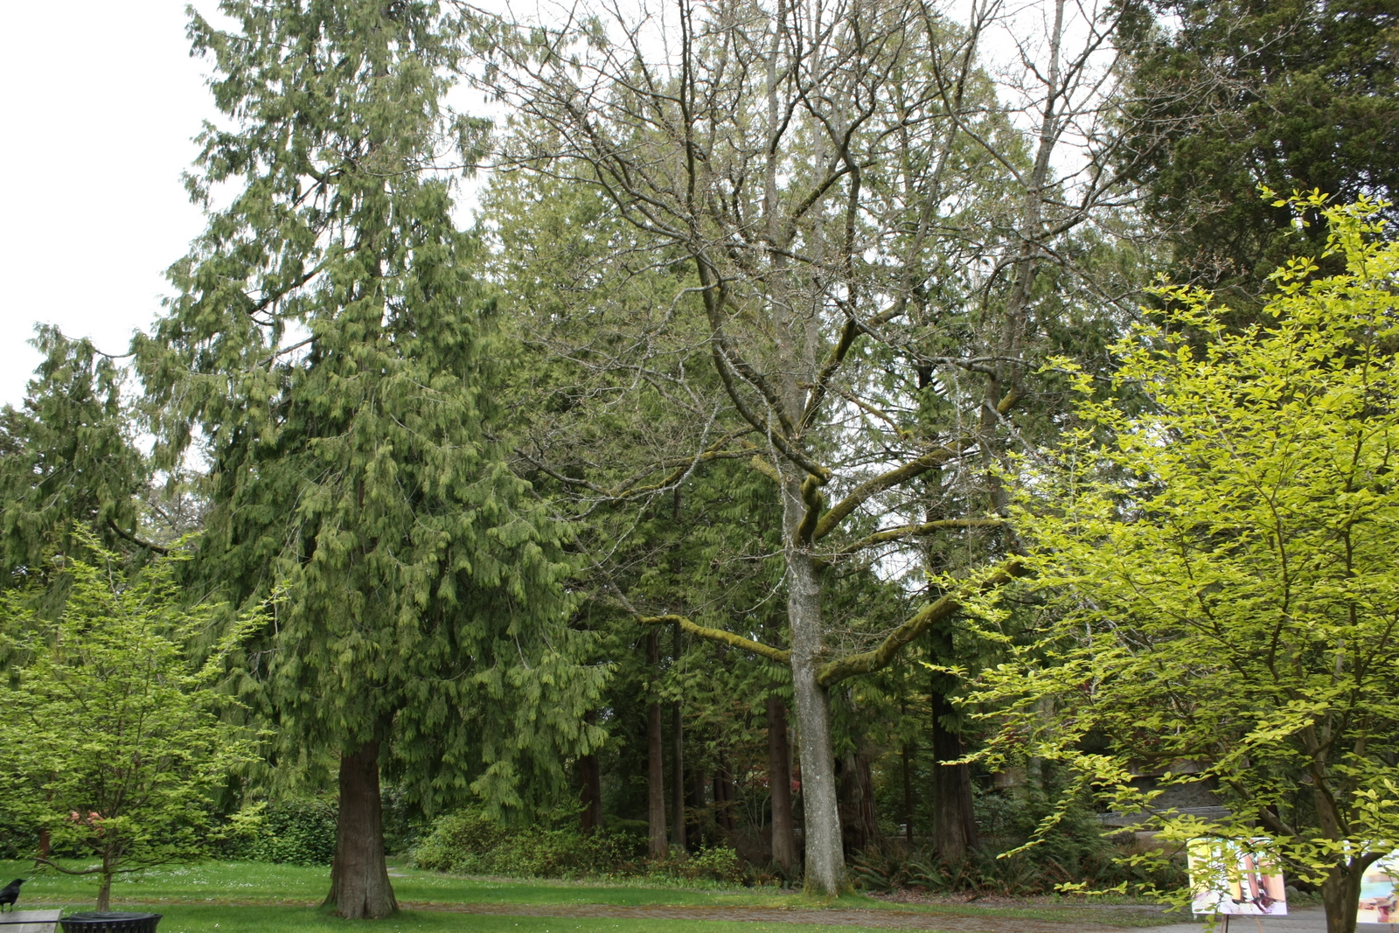
Comparing trees is more complicated!

Slide 17
Comparing trees is more complicated!
What about comparing them?

Slide 18
Definitions

Slide 19
Tree
Set of nodes and links that express the parent-to-child relationship.
Where each node:
Is uniquely labeled in the tree.
Contains one or more numeric variables with values over time.
Contains one or more categorical attributes that may have more than one value.

Slide 20
Types of Trees

Slide 21

Types of Trees
Fixed
State
County
City

Slide 22
Types of Trees
Fixed
Dynamic
State
Gender
County
Ethnicity
City
Age range

Slide 23
Types of Trees
Fixed
Dynamic
Mixed
State
Gender
Gender
County
Ethnicity
State
City
Age range
City

Slide 24
Types of Tree Comparison
Node value changes
No
Yes
No
Topology
changes
Yes
Leaf values
(aggregated trees)
Values in all nodes
Notes:
Add the light grid

Slide 25
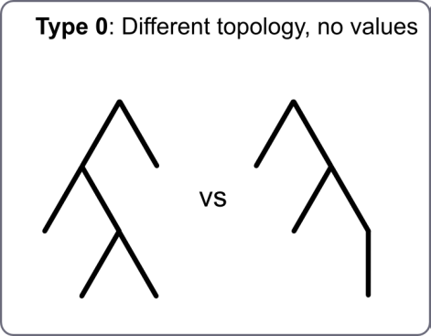
Types of Tree Comparison
Node value changes
No
Yes
No
Topology
changes
Yes
Leaf values
(aggregated trees)
Values in all nodes
Notes:
Add the light grid

Slide 26
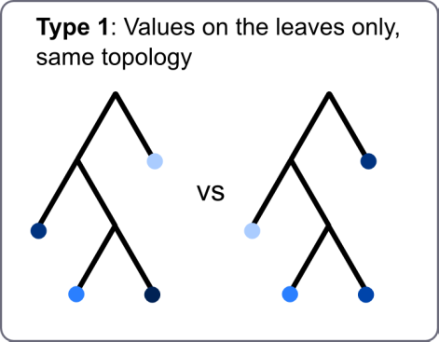
Types of Tree Comparison
Node value changes
No
Yes
No
Topology
changes
Yes
Leaf values
(aggregated trees)
Values in all nodes
Notes:
Add the light grid

Slide 27
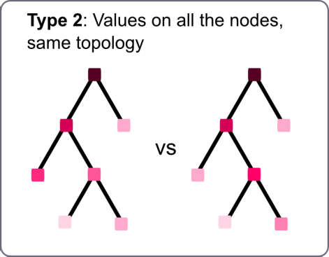
Types of Tree Comparison
Node value changes
No
Yes
No
Topology
changes
Yes
Leaf values
(aggregated trees)
Values in all nodes
Notes:
Add the light grid

Slide 28
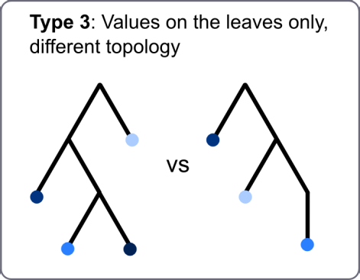
Types of Tree Comparison
Node value changes
No
Yes
No
Topology
changes
Yes
Leaf values
(aggregated trees)
Values in all nodes
Notes:
Add the light grid

Slide 29
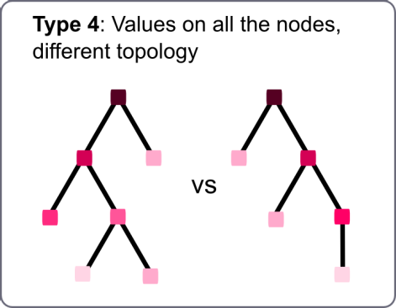
Types of Tree Comparison
Node value changes
No
Yes
No
Topology
changes
Yes
Leaf values
(aggregated trees)
Values in all nodes
Notes:
Add the light grid

Slide 30
Types of Tree Comparison
Node value changes
No
Yes
No
Topology
changes
Yes
Leaf values
(aggregated trees)
Values in all nodes
Notes:
Add the light grid

Slide 31
Types of Tree Comparison
Addressed by related work
Node value changes
No
Yes
No
Topology
changes
Yes
Leaf values
(aggregated trees)
Values in all nodes
Notes:
Add the light grid

Slide 32
Types of Tree Comparison
Addressed by related work
Node value changes
No
Yes
No
Topology
changes
Yes
Leaf values
(aggregated trees)
Values in all nodes
Notes:
Add the light grid

Slide 33
Types of Tree Comparison
Addressed by related work
Node value changes
Partially addressed by related work
No
Yes
No
Topology
changes
Yes
Leaf values
(aggregated trees)
Values in all nodes
Notes:
Add the light grid

Slide 34
Types of Tree Comparison
Addressed by related work
Node value changes
Partially addressed by related work
No
Yes
No
Topology
changes
Yes
Leaf values
(aggregated trees)
Values in all nodes
Notes:
Add the light grid

Slide 35
Types of Tree Comparison
Addressed by related work
Node value changes
Partially addressed by related work
No
Yes
Addressed by TreeVersity
No
Topology
changes
Yes
Leaf values
(aggregated trees)
Values in all nodes
Notes:
Add the light grid

Slide 36
Back to the problem

Slide 37
Product | Category | Refrigerate? | Boxed | QTY | Price
Apples | Fruit | No | No | 230 | $1.5
Oranges | Fruit | No | No | 210 | $5
Milk | Liquids | Yes | Yes | 93 | $2
Bread | Staple | No | No | 105 | $3
Butter | Staple | Yes | Yes | 10 | $10
Orange Juice | Liquids | Yes | Yes | 143 | $4
Cheese | Liquids | Yes | Yes | 150 | $7
Product | Category | Refrigerate? | Boxed | QTY | Price
Apples | Fruit | No | No | 245 | $2
Oranges | Fruit | No | No | 201 | $4
Milk | Liquids | Yes | Yes | 94 | $2
Bread | Staple | No | No | 102 | $3.5
Butter | Staple | Yes | Yes | 15 | $11
Orange Juice | Liquids | Yes | Yes | 170 | $4
Cheese | Liquids | Yes | Yes | 120 | $5
Product | Category | Refrigerate? | Boxed | QTY | Price
Apples | Fruit | No | No | 230 | $3
Oranges | Fruit | No | No | 220 | $4
Milk | Liquids | Yes | Yes | 110 | $4
Bread | Staple | No | No | 92 | $2
Butter | Staple | Yes | Yes | 10 | $8
Orange Juice | Liquids | Yes | Yes | 160 | $3
Cheese | Liquids | Yes | Yes | 150 | $7
Product | Category | Refrigerate? | Boxed | QTY | Price
Apples | Fruit | No | No | 220 | $2
Oranges | Fruit | No | No | 110 | $3
Milk | Liquids | Yes | Yes | 95 | $1
Bread | Staple | No | No | 73 | $2
Cherries | Fruit | No | No | 22 | $7.1
Orange Juice | Liquids | Yes | Yes | 100 | $4
Cheese | Liquids | Yes | Yes | 190 | $7
?
What Changed?

Slide 38
Current solutions

Slide 39
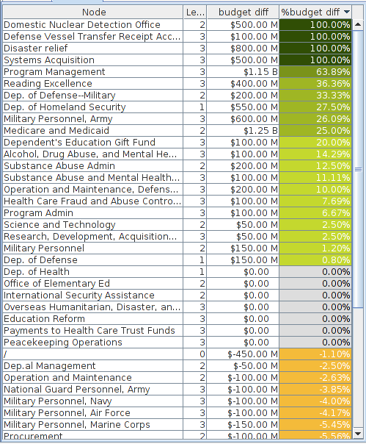
Current solutions

Slide 40
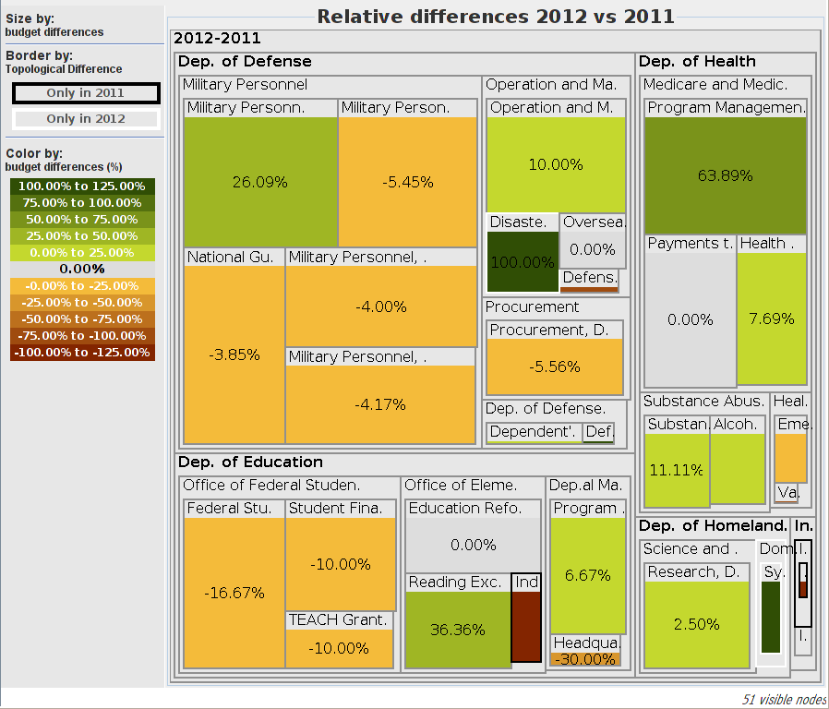
Current solutions

Slide 41
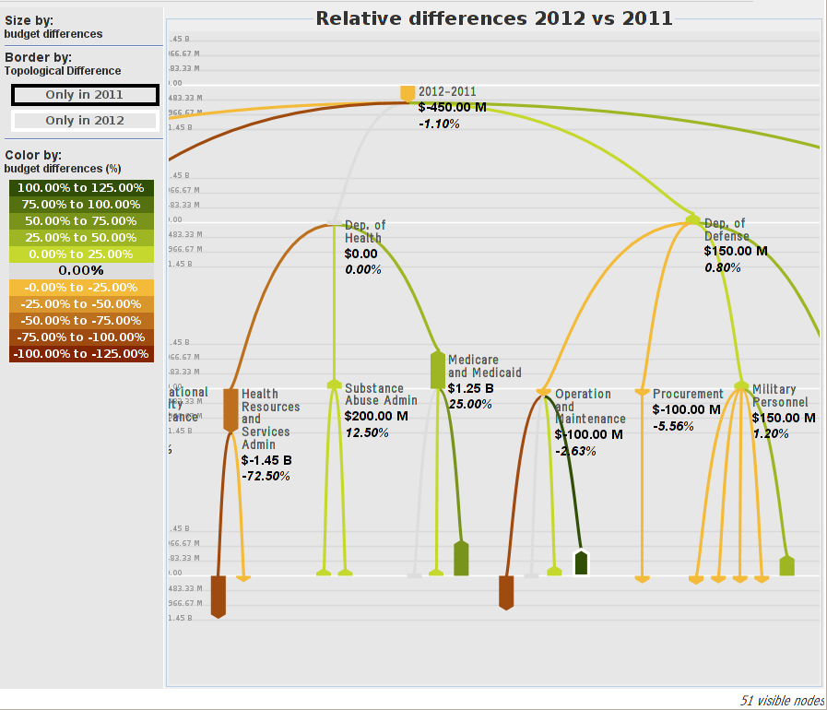
Current solutions

Slide 42
Current solutions
The Bullet [Guerra Gómez, Buck-Colmean, Plaisant, Shnederman 2012]

Slide 43
The StemView: 5 characteristics of change
Notes:
Can’t see the borders

Slide 44
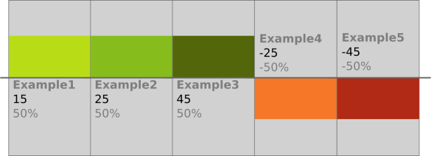
The StemView: 5 characteristics of change
Actual Change (Color)
Notes:
Can’t see the borders

Slide 45
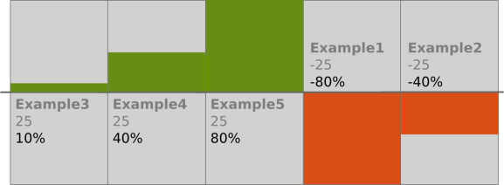
The StemView: 5 characteristics of change
Actual Change (Color)
Relative Change (Height)
Notes:
Can’t see the borders

Slide 46
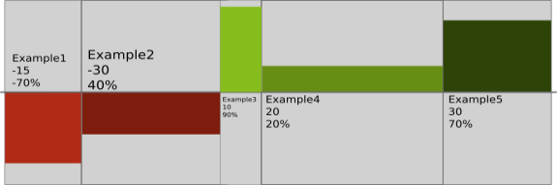
The StemView: 5 characteristics of change
Actual Change (Color)
Relative Change (Height)
Ending Value (Width)
Notes:
Can’t see the borders

Slide 47
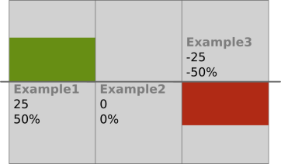
The StemView: 5 characteristics of change
Actual Change (Color)
Direction
Relative Change (Height)
Ending Value (Width)
Notes:
Can’t see the borders

Slide 48
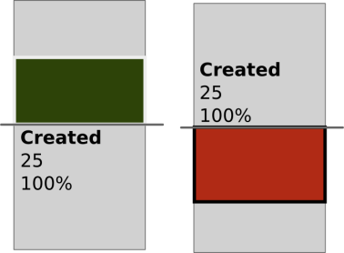
The StemView: 5 characteristics of change
Actual Change (Color)
Direction
Relative Change (Height)
Created
Node
Removed
node
Ending Value (Width)
Border
Notes:
Can’t see the borders

Slide 49
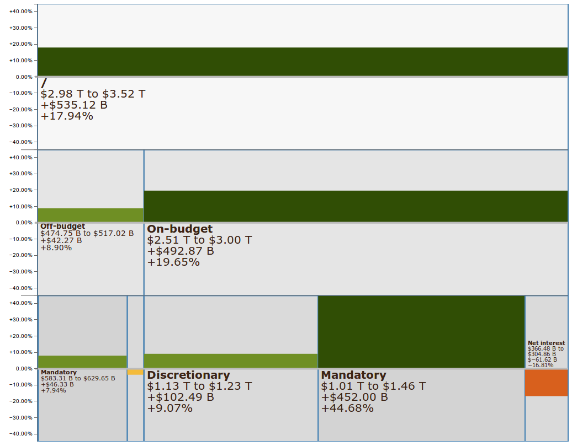
The StemView

Slide 50

Notes:
Progressive animation

Slide 51
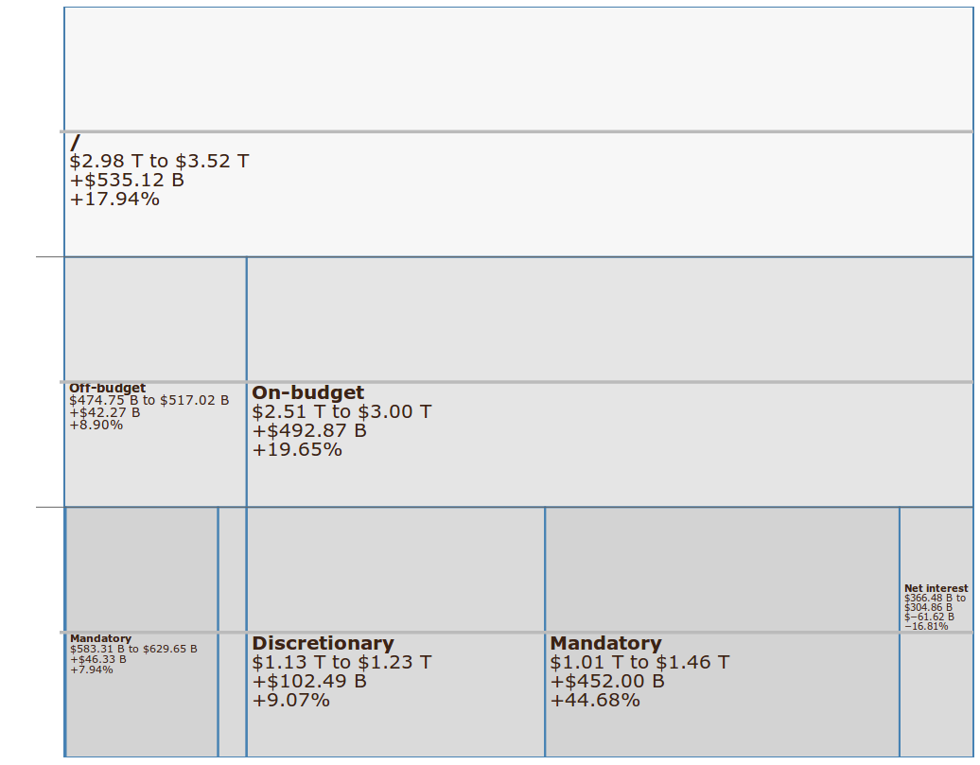

Slide 52
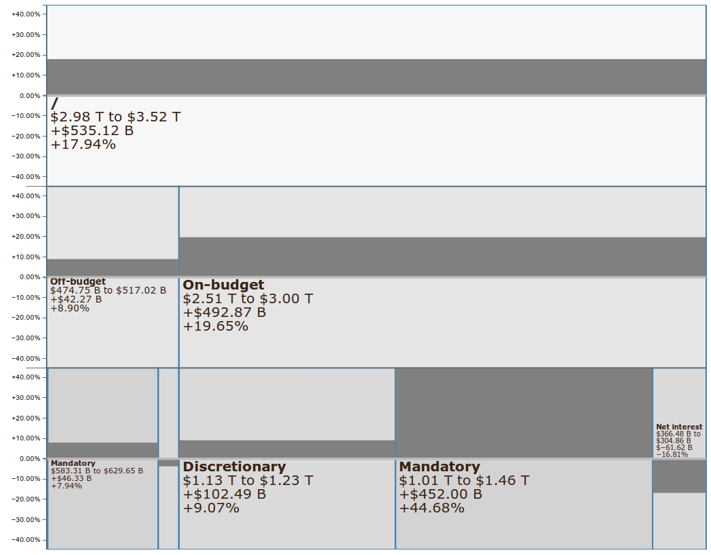

Slide 55


Slide 56
Live Demo

Slide 57
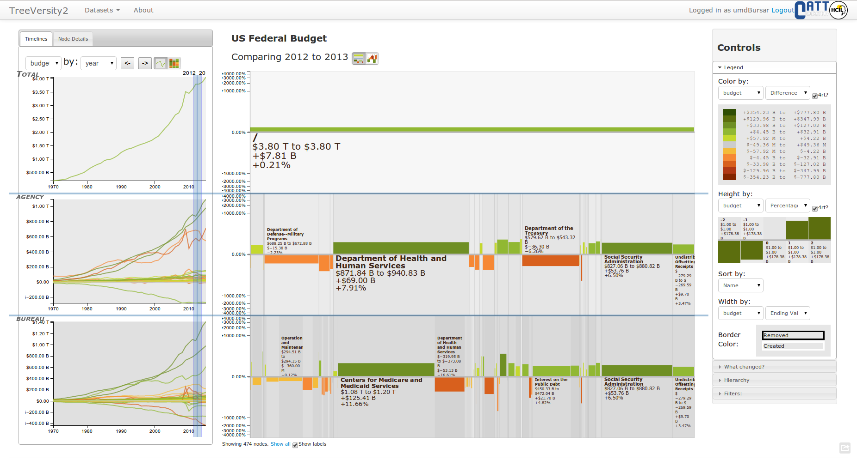
Þ

Slide 58
The Reporting Tool

Slide 59
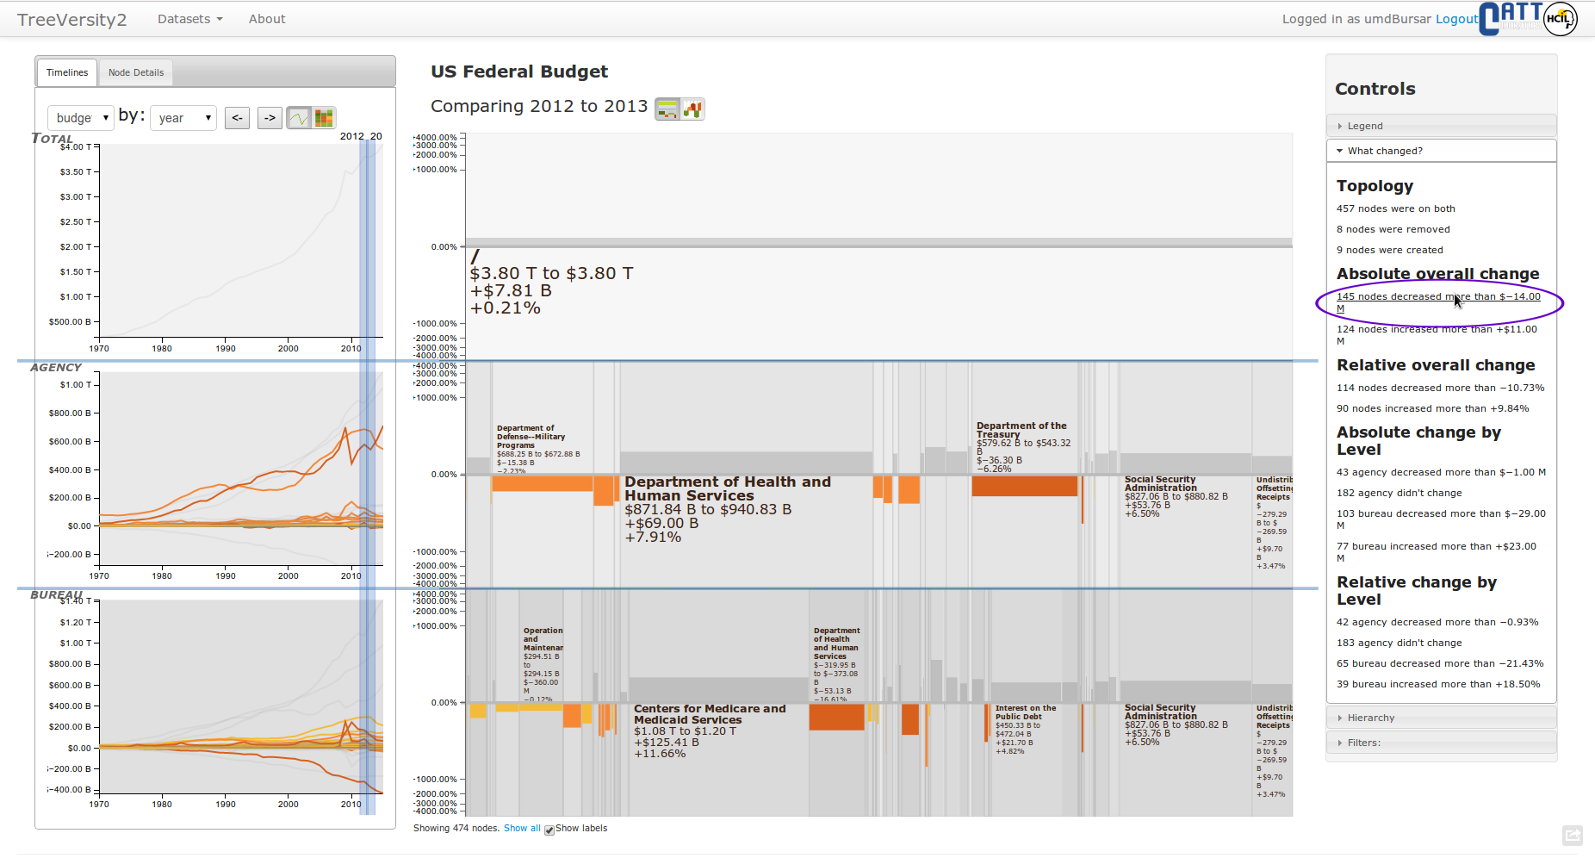

Slide 60
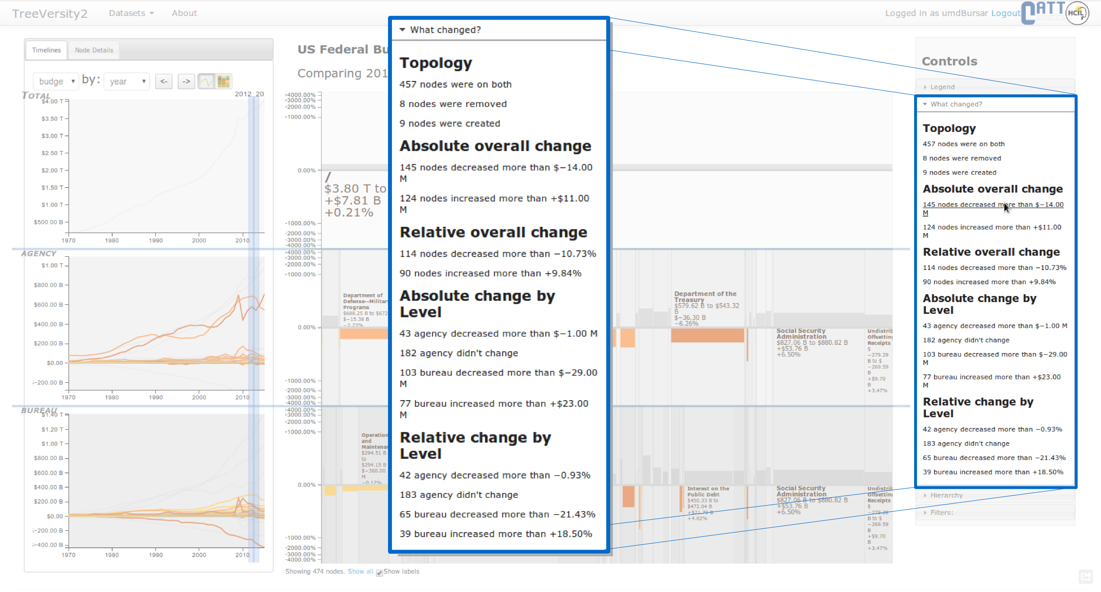

Slide 61

13 Case Studies that revealed strengths & weaknesses
13 case studies with 9 partners

Slide 62







Drugs’ adverse effects
2,964 Records
5 Time points
Type 4 tree comp
Lung cancer death rates
1,716 Records
13 Time points
Type 2 tree comp
Passengers flying in the US
65,524 Records
162 Time points
Type 3 tree comp
Students demographics
227,158 Records
5 Time points
Type 3 tree comp
Product’s sales and inventories
63,068 Records
4 Time points
Type 1 tree comp
US Federal Budget
4,845 Records
56 Time points
Type 3 tree comp
Imports/exports in the continent
119,741 Records
19 Time points
Type 3 tree comp
Traffic bottlenecks data
96,205 Records
24 Time points
Type 3 tree comp

Slide 63
FDA Case Study

Slide 64
The task
How do drug adverse effects change over time?

Slide 65
EBGM: Empiric Bayes Geometric Mean

Slide 66
EBGM: Empiric Bayes Geometric Mean
In human:
An index of how many more than expected reports of an adverse effect have been received

Slide 67
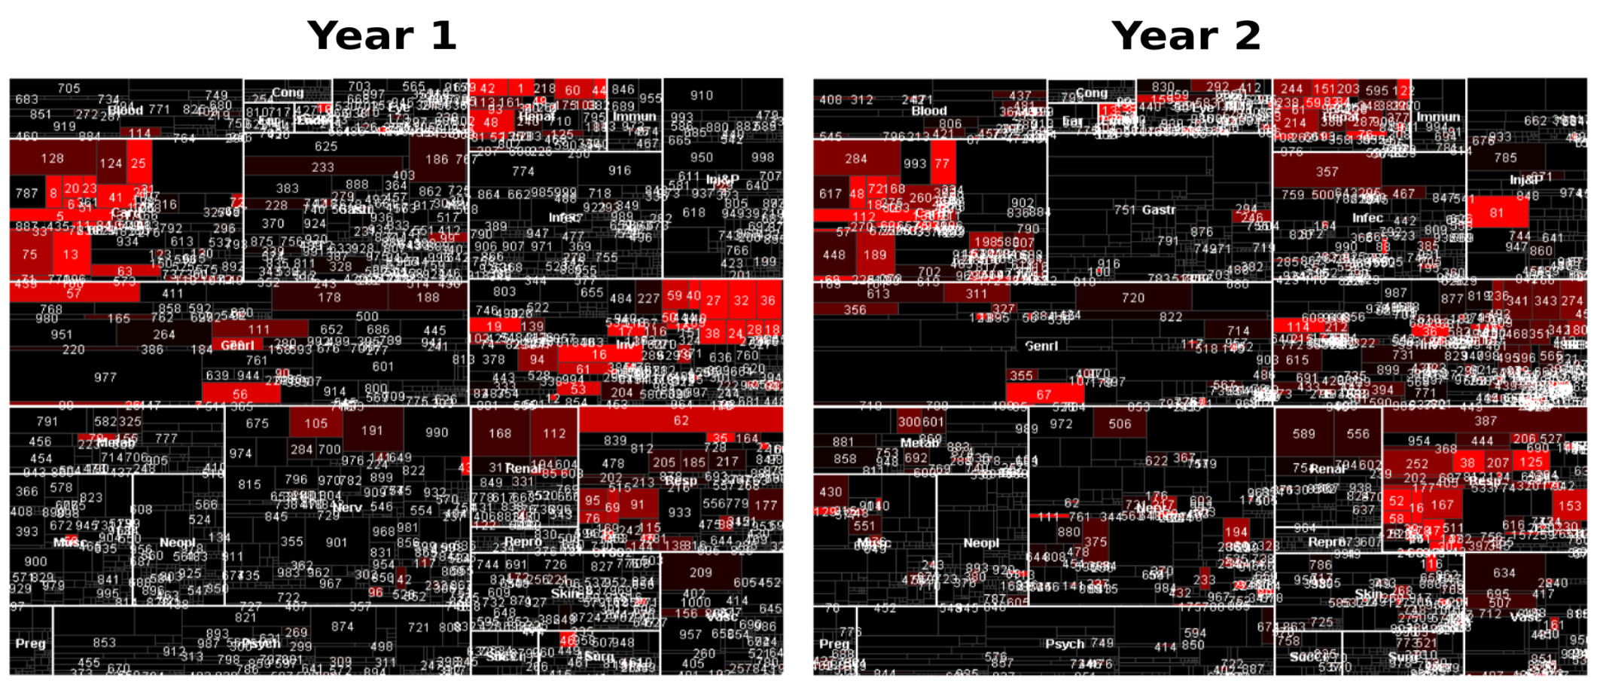
Sector Maps

Slide 68
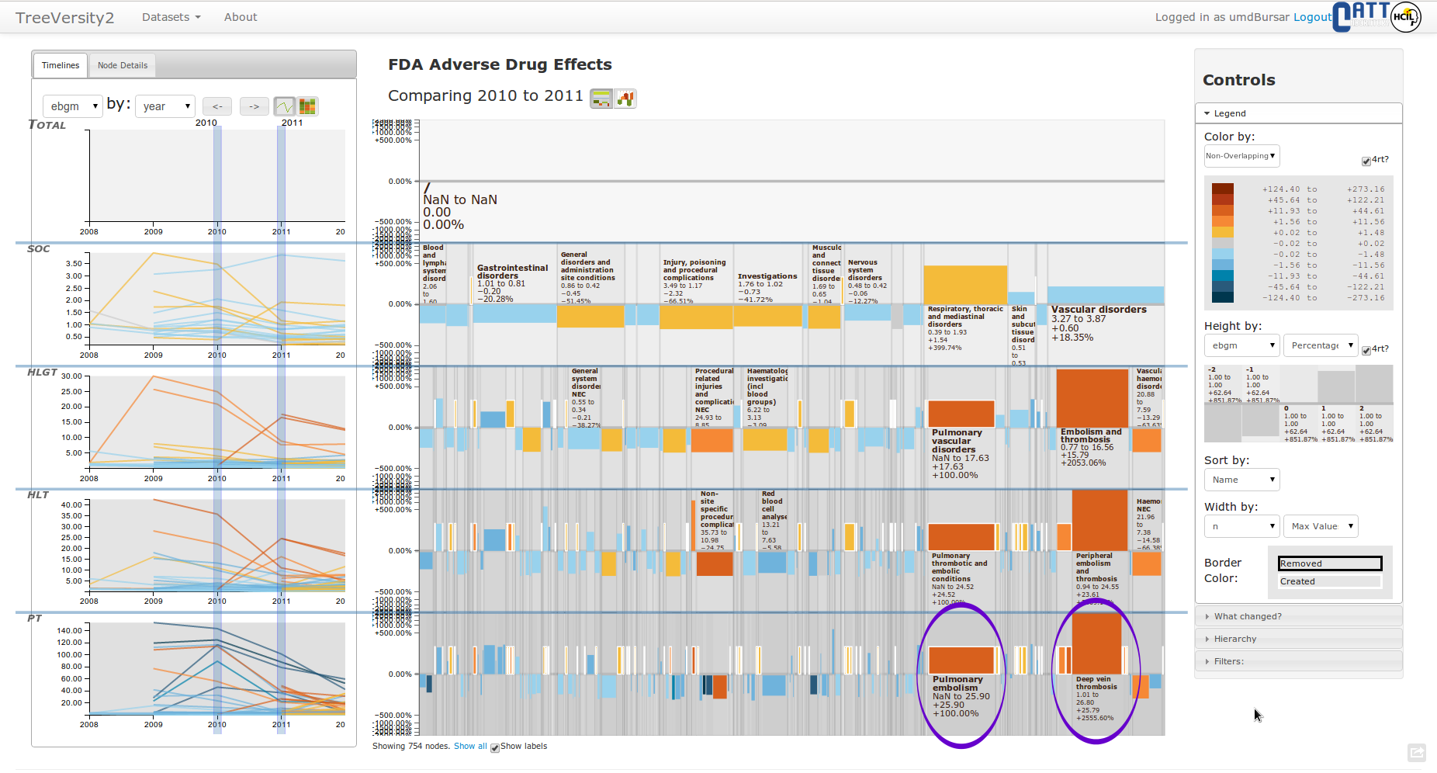

Slide 69
“The work I can achieve with TreeVersity is equivalent to years of analysis with our previous methods”
“TreeVersity easily showed us multi-years of the data in a graphical form at once without having to download the data into excel and create graphics. We can do that analysis now, but TreeVersity was much quicker.”
“I've spent many hours in color coded Excel files expressing changes at query and category levels. The visualization and what changed views made this process much more efficient and easier to share.”
“Numerous examples of obvious, but heretofore unrevealed patterns were discovered.”
“We use Hyperion and excel for analysis. However, TreeVersity made it much easier to see multi-year trends.”

Slide 70
We need to run it in-site, and cannot install all the requirements
It shows too much information
We need to see more information
It requires some training to understand the StemView

Slide 71
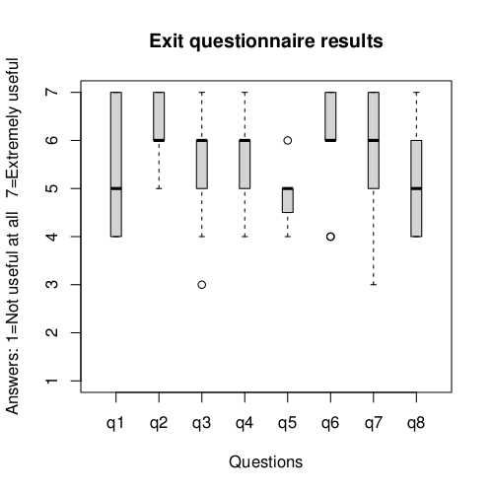
q1: For this particular case study TreeVersity was:
q2: In general the tool is likely to be:
q3: Did the reporting tool help direct your exploration?
q4: Did you find the StemView comprehensible?
q5: Did you find the Bullet comprehensible?
q6: Would you like to continue working with Treeversity?
q7: Would you be willing to install and use Treeversity on your own?
q8: How does this compare to your original expectations before starting with the tool.

Slide 72
q2: In general TreeVersity2 is likely to be
1: Not useful at all
7: Extremely useful

Slide 73
q4: Did you find the StemView comprehensible?
1: Not comprehensible at all
7: Extremely easy to comprehend

Slide 74
q6: Would you like to continue working with Treeversity
1: Not at all
7: I will definitely use it

Slide 75
Acknowledgements
Center for Advanced Transportation Technologies (CATT Lab)
The Center for Integrated Transportation Systems Management
The Fulbright International Science and Technology Scholarship
Audra Buck-Coleman
Palo Alto Research Center, a Xerox Company
Our Reviewers
Our case studies partners

Slide 76
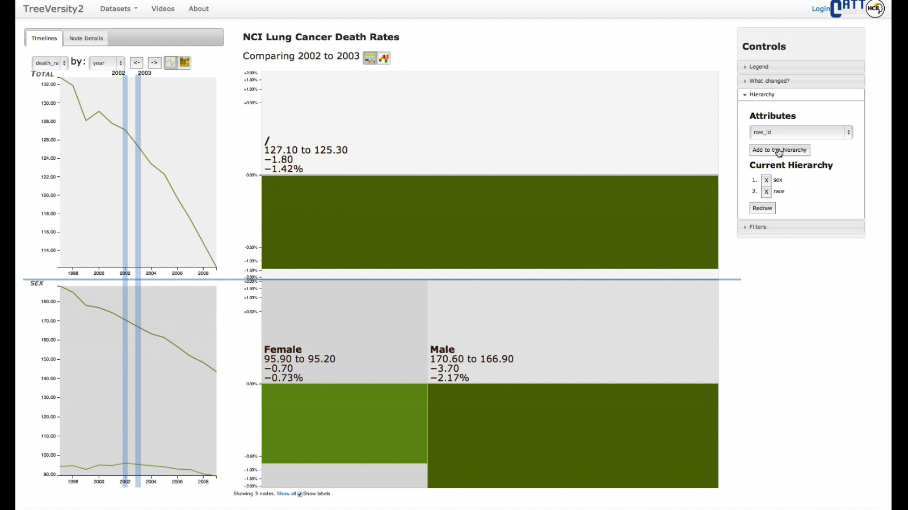
Thank you!
StemView shows 5 characteristics of change
Dynamic/Fixed/Hybrid Hierarchies that aggregate or not
Created and removed nodes
Not only leaf nodes
Reporting tool
http://treeversity.cattlab.umd.edu
John Alexis Guerra Gómez
@duto_guerra
http://duto.co/aguerra

